Slide 1
Introduction to css

Slide 2
CSS
CSS stands for Cascading Style Sheet.
CSS is used to design HTML tags.
CSS is a widely used language on the web.
CSS describes how HTML elements are to be displayed on screen, paper, or in other media.
CSS saves a lot of work. It can control the layout of multiple web pages all at once
External style sheets are stored in CSS files

Slide 3
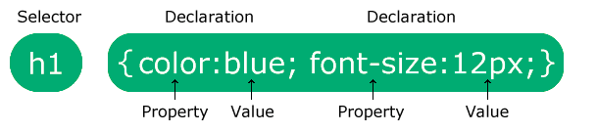
CSS syntax
A CSS rule consists of a selector and a declaration block.
CSS Syntax:
The selector points to the HTML element you want to style.
The declaration block contains one or more declarations separated by semicolons.
Each declaration includes a CSS property name and a value, separated by a colon.
Multiple CSS declarations are separated with semicolons, and declaration blocks are surrounded by curly braces.

Slide 4
CSS example
Example: p { color: red; text-align: center; }
p is a selector in CSS (it points to the HTML element you want to style: <p>).
color is a property, and red is the property value
text-align is a property, and center is the property value

Slide 5
Css selectors
CSS selectors are used to select the content you want to style. Selectors are the part of CSS rule set. CSS selectors select HTML elements according to its id, class, type, attribute etc.
There are several different types of selectors in CSS. We will discuss here a few main and most commonly used selectors.
CSS Element Selector
CSS Id Selector
CSS Class Selector
CSS Universal Selector
CSS Group Selector
Pseudo-class selector
Pseudo-element selector

Slide 6
Css element selector
The element selector selects HTML elements based on the element name.
Example:
Here, all <p> elements on the page will be center-aligned, with a red text color:
p {
text-align: center;
color: red;
}

Slide 7
Css id selector
The id selector uses the id attribute of an HTML element to select a specific element.
The id of an element is unique within a page, so the id selector is used to select one unique element!
To select an element with a specific id, write a hash (#) character, followed by the id of the element.
Example:
The CSS rule below will be applied to the HTML element with id="para1":
#para1 {
text-align: center;
color: red;
}

Slide 8
Css class selector
The CSS classes allow us to define multiple CSS properties in a single block and when that class is added to any element then all the specified CSS property is reflected in the HTML element.
To select elements with a specific class, write a period (.) character, followed by the class name.
Example:
In this example all HTML elements with class="center" will be red and center-aligned:
.center {
text-align: center;
color: red;
}

Slide 9
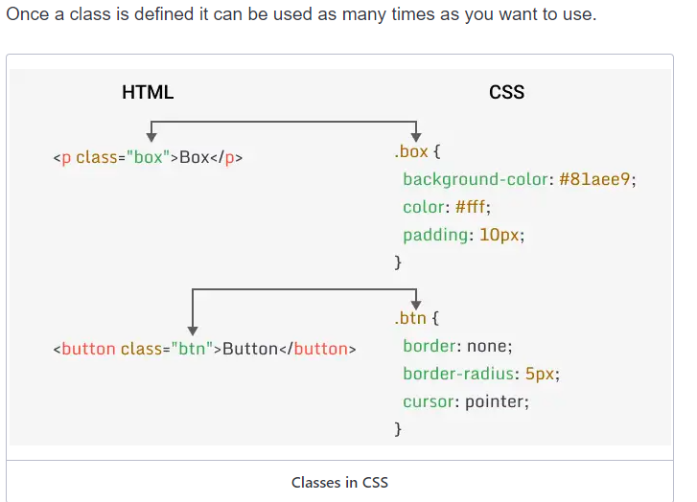
Css class selector

Slide 10
Css class selector
You can also specify that only specific HTML elements should be affected by a class.
Example
In this example only <p> elements with class="center" will be red and center-aligned:
p.center {
text-align: center;
color: red;
}

Slide 11
Css Universal selector
The universal selector (*) selects all HTML elements on the page.
Example
The CSS rule below will affect every HTML element on the page:
* {
text-align: center;
color: blue;
}

Slide 12
Css Grouping selector
The grouping selector selects all the HTML elements with the same style definitions.
Example
In this example we have grouped the selectors from the code above:
h1, h2, p {
text-align: center;
color: red;
}

Slide 13
How to add css
CSS is added to HTML pages to format the document according to information in the style sheet. There are three ways to insert CSS in HTML documents.
Inline CSS
Internal CSS
External CSS

Slide 14
Inline css
Inline style is the CSS code that is written within the HTML element itself. It is used to add a unique style to a single element.
The inline style has the highest priority among internal and external CSS. Inline style overwrites external or internal CSS.
The inline element is used by elements by assigning style attributes to them and defining CSS property inside quotes as a key-value pair. Example <p style="color: blue;">Hello World!</p>.
Example: <body style="background-color:#df8C61">

Slide 15
Internal CSS in HTML
Another way to include CSS in an HTML file is internal CSS.
Internal CSS is the CSS code that is written within the HTML file itself within the <style> element and is placed in the <head> section of the HTML file.
The Internal style is mainly used when you need some other CSS property for a single HTML file.
<head>
<style>
body { background-color: #df8C61; }
</style>
</head>

Slide 16
External CSS in HTML
External CSS is the most common and efficient way to include CSS in HTML files. In this method, you will create a separate CSS file and link it to your HTML file.
make a separate file and save it with the .css extension and write your CSS code in it.
Now to link this CSS file to your HTML file, you need to use <link> tag in the <head> section of your HTML file.
To connect a CSS file give the URL of the stylesheet to the href attribute and set rel="stylesheet".
Suppose your file name is "external.css" that lies in the same folder as your HTML file then you can write <link rel="stylesheet" href="external.css">.

Slide 17
External CSS in HTML
Example:
<head>
<link rel="stylesheet" href="external.css">
</head>
This external CSS file should purely contain CSS code.
Benefits of using external style
Clean: Since you, CSS classes, and properties are stored in a separate file so your HTML file looks clean.
Management: Change at a single property can reflect all over the webpage.

Slide 18
CSS Properties
A CSS property assign a style or behavior to an HTML element.
There are several different CSS properties, such as:
CSS Color
CSS Background
CSS Fonts
CSS Margins
CSS Links
CSS Tables

Slide 19
CSS color
Color is one of the most important aspects of web design. It is used to make the website look more attractive and appealing. It is also used to convey a message to the user.
Colors are specified using predefined color names, or RGB, HEX, color names.
RGB color is defined using the rgb() function. It takes three parameters, red, green, and blue. Each parameter can have a value from 0 to 255.
For example, rgb(255, 0, 0) is red, rgb(0, 255, 0) is green, and rgb(0, 0, 255) is blue.

Slide 20
CSS color
HEX color is defined using the hexadecimal notation. It is a six-digit code that represents the amount of red, green, and blue in a color, preceded by a # sign.
Color is defined as #rrggbb where rr represents the color red, gg represents the color green and bb represents the color blue.
For example, #ff0000 is red, #00ff00 is green, and #0000ff is blue.

Slide 21
Css color names
There are 147 predefined color names in CSS. You can use any of these color names in your CSS code.
Some of the most commonly used color names are:
red
green
blue
yellow
orangeblack
white
gray

Slide 22
Css background
The CSS background properties are used to add background effects for elements.
The background properties are:
background-color
background-image
background-position
background-repeat
background-attachment
background-size

Slide 23
Css background
background-color
The background-color property is used to set the background color of an element. The background color can be set to any color value, including hex, RGB, RGBA, HSL, HSLA, and color keywords.
The following example sets different background colors for elements.
Example
.element1 {
background-color:
red;
}
.element2 {
background-color:
#a5e680;
}

Slide 24
Css background
background-image
The background-image property sets the background image of an element.
To set a background image, you must specify the URL of the image using the url() function. The URL must be enclosed in quotes.
Example
.element1 {
background-image: url('flower.jpg');
}
.element2 {
background-image: url('cat.jpg');
}

Slide 25
Css background
background-position
The background image that we set using the background-image property can be positioned anywhere on the background layer. The default position of the background image is top left.
However, the background image can be positioned anywhere on the background layer using the background-position property using the following values:
top
bottom
left
right
center
x% y%
xpos ypos

Slide 26
Css units
CSS has several measurement units for length and size. These measuring units are used to specify a non-zero value to the CSS properties.
CSS units are used where we need to define size, length, etc. EX - height, width, border-size, padding, font-size etc.
CSS units can be categorized into two types:
Absolute unit
Relative unit

Slide 27
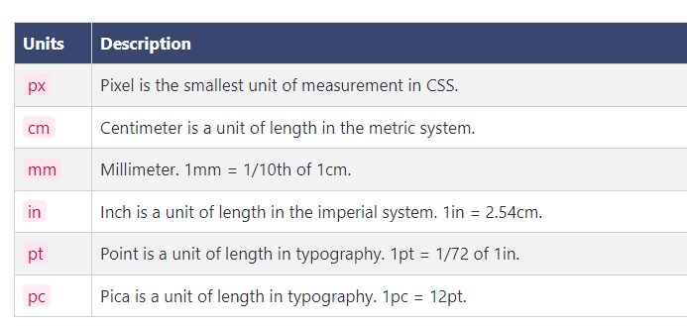
Css units
Absolute Unit
These units are fixed and do not change with the size of the viewport. These units are used to specify the size of the element in the document. EX - height, width, border-size, padding, font-size etc.

Slide 28
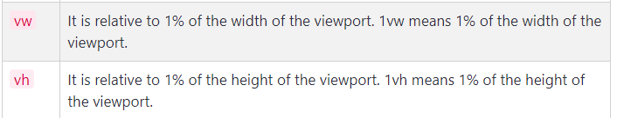
Css units
Relative unit
The relative unit is a unit of measurement that is relative to another value. The value is relative to the parent element. This means if the parent element is changed, the child element will change accordingly.

Slide 29
Css fonts
CSS font properties are used to control the appearance of text. The font properties allow you to specify many aspects of the text, such as the font family, font size, font weight, font style, and more.
The different CSS font properties are:
font-family
font-size
font-style
font-weight
font-variant
line-height

Slide 30
Css fonts
The font-family property is used to specify the font family for an element. The font family is a list of one or more font family names and/or generic family names. The browser will select the first font that is installed on the computer.
Using CSS property font-family we specify the family to the HTML elements.
Example
h1 { font-family:"sans-serif"; }
h2 { font-family:"monospace"; }
p { font-family:"Times New Roman"; }

Slide 31
Css fonts
CSS font-size property is used to set the size of the font. The font size may be specified in absolute or relative terms.
Using this property we can resize the font by choosing any scale like px, em, rem, pt, %, etc.
Example
h1 { font-size:40px; }
h2 { font-size:1.8em; }
p { font-size:120%; }

Slide 32
Css fonts
CSS font-style property is used to set the font style of an HTML document.
Using this property we can choose font style like normal, italic, oblique etc.
normal - font is normal.
oblique - font is little leaning.
italic - font is italic.oblique and italic looks similar.
Example
h2 { font-style:normal; }
h3 { font-style:oblique;}
p { font-style:italic; }

Slide 33
Css fonts
CSS font-weight property is used to define the weight of the font and manages the boldness of the font.
The value of this property can be set in numbers like 100, 200, 300, 400, 500, 600, 700, 800, and 900 or in keywords like normal, bold, bolder, and lighter.
Example
h1 { font-weight:500; }
p { font-weight: 600; }
div { font-weight: bold; }

Slide 34
Css fonts
CSS font-variant property is used to define whether or not a text should be displayed in a small-caps font.
font-variant: small-caps make small text capital but those tests which convert to capital are smaller in size than those of original capital text present in the paragraph.
Example
<h2 style="font-variant:normal">This heading has normal font-variant property.</h2>
<p style="font-variant:small-caps">This Paragraph Has Small-caps Font-variant Property.</p>

Slide 35
Css fonts
CSS line-height property is used to set the space between lines of text.
Using this property we can set the space between lines of text in pixels, percentage, length, or normal.
Example
h1 { line-height: 1.5; }
p { line-height: 2; }

Slide 36
Css text style
CSS provides us the ability to style the text using its text formatting properties. These properties are used to change the appearance of the text.
Some of its text formatting properties are:
Text color
Text align
Text shadow
Text indent
Text decoration
Text transform

Slide 37
Css text style
CSS Text Color
Using color property in CSS you can set the color of the text of any HTML element.
Color values can be specified in the following ways:
Using color names like red, blue, green, etc.
Using hexadecimal value like #ff0000, #0000ff, #00ff00, etc.
Using RGB value like rgb(255, 0, 0), rgb(0, 0, 255), rgb(0, 255, 0), etc.
Using HSL value like hsl(0, 100%, 50%), hsl(240, 100%, 50%), hsl(120, 100%, 50%), etc.

Slide 38
Css text style
CSS Text align
Using the text-align property in CSS you can align the text of any HTML element in the horizontal direction.
The value of text-align can be set to left, right, center, justify, or initial.
Example
.left { text-align:left; }
.left { text-align: right; }
.left { text-align: justify; }

Slide 39
Css text style
CSS Text shadow
The text-shadow property is used to create a shadow effect on the texts.
The value of text-shadow has 4 parts of value. They are:
horizontal offset - It is the distance between the shadow and the text in the horizontal direction.
vertical offset - It is the distance between the shadow and the text in the vertical direction.
blur radius - It is the blur radius of the shadow.
color - It is the color of the shadow.

Slide 40
Css text style
CSS Text decoration
text-decoration property is used to decorate text by creating underline, overline, line-through, or none.
It is used to remove the underline from any link.
Example
.decoration {
text-decoration: underline;
}

Slide 41
Css text style
CSS Text transform
The text-transform property is used to transform the text either in uppercase or in lowercase.
Using this property one can convert uppercase into lowercase and lowercase into uppercase also the first letter of the word can be capitalized.
Example
.transform-1 {
text-transform: uppercase;
}

Slide 42
Css link
With CSS, links can be styled in many different ways.
Styling Links
Links can be styled with any CSS property (e.g. color, font-family, background, etc.).
Example
a {
color: hotpink;
}

Slide 43
Css link
In addition, links can be styled differently depending on what state they are in.
The four links states are:
a:link - a normal, unvisited link
a:visited - a link the user has visited
a:hover - a link when the user mouses over it
a:active - a link the moment it is clicked

Slide 44
Css lists
Lists are used to display a group of related items in an ordered or unordered manner.
Unordered lists are shown with a bullet point, and ordered lists are shown with numbers.
Using CSS we can style these list items in a variety of ways. We can change the color, size, and style of the bullets, and we can also change the position of the list items.

Slide 45
Css lists
In CSS we have following list properties to style list:
list-style-type - This property is used to change the shape of the bullet point.
list-style-position - It controls the content to be displayed before or after the list item.
list-style-image - It is used to add an image as a bullet point.

Slide 46
Css lists
The list-style-type property is used to change the shape of the bullet point. It can be used with both ordered and unordered lists.
The values that can be used with this property are:
disc - Used to display a filled circle as a bullet point.
circle - Used to display an empty circle as a bullet point.
square - Used to display a filled square as a bullet point.
decimal - Used to display numbers as a bullet point.

Slide 47
Css lists
decimal-leading-zero - Used to display numbers with a leading zero as a bullet point.
lower-roman - Used to display lowercase roman numbers as a bullet point.
upper-roman - Used to display uppercase roman numbers as a bullet point.
lower-alpha - Used to display lowercase alphabets as a bullet point.
upper-alpha - Used to display uppercase alphabets as a bullet point.
none - Used to remove the bullet point.

Slide 48
Css tables
CSS table style
Here are some of the CSS properties that you can use to style your table.
Border
cell-spanning
Table Caption
Text align
Background

Slide 49
Css tables
Border in Table
Tables do not have borders by default. You can add borders to the table using the border property.
Select table, th, and td and apply the border property.
table, th, td {
border: 1px solid black;
}

Slide 50
Css tables
Cell spanning multiple rows or column
By default, a cell can only contain one value. But you can make a cell span multiple rows or columns using the rowspan and colspan attributes.
For spanning multiple rows or columns we can use the attribute rowspan for multiple row span and colspan for multiple column span and set the value to the number of rows or columns you want to span.

Slide 51
Css tables
Table Caption
The table caption is a short description of the table. It is displayed above the table. You can use the caption-side property to position the caption.
Use <caption> tag to create a caption for the table. This tag must be immediately used after the table tag.

Slide 52
Css tables
Text alignment in the table
In the grids of rows and columns, texts can be aligned horizontally and vertically.
To align text horizontally use the text-align property.
To align text vertically use the vertical-align property.
Example
th {
text-align:center;
}
tr {
height:15px;
vertical-align:bottom;
}

Slide 53
Css tables
Background color in table
Using CSS we can add background color to the table element. In this example we have created a zebra effect using nth.child() and background-color property.
Example
tr:nth-child(even) {
background-color:
silver;
}

Slide 54
Css forms
The look of an HTML form can be greatly improved with CSS:
Styling input fields
Use the width property to determine the width of the input field:
Example
input {
width: 100%;
}
The example above applies to all <input> elements. If you only want to style a specific input type, you can use attribute selectors:
input[type=text] - will only select text fields
input[type=password] - will only select password fields
input[type=number] - will only select number fields

Slide 55
Css forms
Giving padding to input fields
Padding creates space between the border and the content of the input field. Which looks nice.
To give padding to the input fields, you can use the padding property.
Example
input {
padding: 10px;
}

Slide 56
Css forms
Adding border and border-radius
The border is the line that surrounds the input field. It increases the visibility of the input field.
To give a border to the input fields, you can use the border property, and to give border-radius to the input fields, you can use the border-radius property.
Example
input {
border: 2px solid #cd5c5c;
border-radius: 5px;
padding: 10px;
}

Slide 57
Css forms
Changing the background color
To change the background color of the input fields, you can use the background-color property.
Choose a color that is different from the background color of the page. This will make the text more visible.
Example
input {
background-color: #ff9f9f;
color: white;
margin: 10px 0;
padding: 10px;
border: none;
}

Slide 58
Css forms
Change input filed when it is focused
When an input field is focused, it means that the user is currently typing in that input field.
To show that the input field is focused, you can change its styling.
Use the :focus pseudo-class to select the input field when it is focused.
Example
input:focus {
background-color: #ff9f9f;
color: white;
}

Slide 59
Css buttons
Basic Styles for Buttons
border - Sets the border of the button.
padding - It helps to give the correct size to the button.
background-color - Sets the background color of the button.
color - Sets the color of the text inside the button.
box-shadow - It helps to give a shadow effect to the button.
font-size - Sets the font size of the text inside the button.
border-radius - It helps to give rounded corners to the button.
cursor - It helps to change the cursor when it is over the button.
hover - It helps to change the style of the button when the cursor is over the button. It is also called pseudo-class.

Slide 60
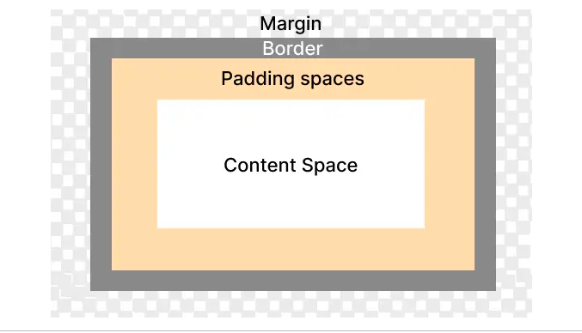
Css box model

Slide 61
Css box model
Content
Content is the main part of the box model. It is the actual text or image that is displayed on the page.
It is surrounded by padding of the element (if any).
Padding
Padding is the internal space of the box model around the content. It takes its own space.
It is surrounded by the border of the element.

Slide 62
Css box model
Border
The border is the line that surrounds the padding and content of the element.
It is surrounded by the margin of the element.
Margin
Margin is the external space of the box model. It is the space between the border of the element and the border of the adjacent element.
It is not part of the element.

Slide 63
Css display
CSS display property defines how an HTML element is displayed on the webpage.
There are mainly 6 values of CSS display property.
block - The element is displayed as a block element. It starts on a new line and takes up the whole width.
inline - The element is displayed as an inline element. It does not start on a new line. It only takes up as much width as necessary.
inline-block - The element is displayed as an inline-level block container. The element itself is formatted as an inline element, but you can apply height and width values.
none - The element is completely removed. It will not be displayed, and it will not take up any space.
flex - The element is displayed as a block-level flex container.
grid - The element is displayed as a block-level grid container.

Slide 64
Css flexbox
CSS flexbox is a one-dimensional web layout method that is used to arrange HTML containers in a row or column.
Flexbox or CSS flexbox allows the HTML elements to get automatically arranged depending on screen sizes.
Before CSS flexbox it was quite difficult to fit and align-items on a webpage. The items were mostly laid out using float and position properties. Even though using just float and position properties we were unable to perform many tasks like:
Aligning items vertically
Making child element take up equal space even with unequal length of items

Slide 65
Css flexbox
To start with flexbox we first need to define flexbox in our parent element so that other properties of flexbox could be used by the parent as well as a child element.
To make the container a flexible box define display: flex or display: inline-flex to the container:
display: flex makes the container itself behave like a block element
display: inline-flex makes container behave like inline element
Example
.container {
display: flex; /* or inline-flex */
}

Slide 66
Css flexbox
CSS that is applied on the container itself (Parent) - Flexbox properties which is applied on the container itself are as follows:
flex-direction
flex-wrap
flex-flow
justify-content
align-items
align-content

Slide 67
Css GRid
The CSS Grid Layout Module offers a grid-based layout system, with rows and columns, making it easier to design web pages without having to use floats and positioning.
A grid layout consists of a parent element, with one or more child elements.

Slide 68
Css media query
What is a media query?
Media query is a technique introduced in CSS3 which let users define different CSS styles for different devices and different screen sizes.
It can modify the appearance and even behaviour of your webpage based on certain matched conditions.
Media query is mainly used to target a particular viewport range. It uses the @media rule with the condition to define a block of CSS which is applied to element when the condition is true. Here is an example we will discuss in detail later in this section.

Slide 69
Css media query
A Media query has 4 different parts:
At-rule (@media) - Media query starts with the @media ruleset itself.
Logical operator (not, or, and) - Media query support logical operators like other programming languages like and, not, or (comma) and only.
Media type (screen, printer, etc) - It defines the type of media we are targeting like print, screen, speech or all.
Media-feature (width, max-width, height, etc) - Media feature target match features like width, height, aspect-ratio, orientation, etc.

Slide 70
Css media query
Example:
/* applied on screensize of 768px and above */
@media screen and (min-width:768px) {
.box {
/* apply your style */
}
}

